Slide 1
Spotlight on Big Data
Adventures in Distributed Computing with Spark and H2O
A. Macfie, P. Boily

Slide 2
Case Study
Danish Medical Data

Slide 3
Case Study Danish Medical Data – Context
The Danish National Patient Registry contains 68 million health observations on 6.2 million patients over a 15 year time span (Jan ‘96 – Nov ‘10).
Objective: finding connections between different diagnoses and how the presence of a diagnosis at some point in time might allow for the prediction of another diagnosis at a later point in time.
[Jensen et al., Temporal disease trajectories condensed from population-wide registry data covering 6.2 million patients, Nature Communications]

Slide 4
Case Study Danish Medical Data – Methodology
1. Compute strength of correlation for pairs of diagnoses over a 5 year interval on a representative subset of the data
2. Test diagnoses pairs for directionality (one diagnosis repeatedly occurring before the other)
3. Determine reasonable diagnosis trajectories (thoroughfares) by combining smaller (but frequent) trajectories with overlapping diagnoses
4. Validate the trajectories by comparison with non-Danish data
5. Cluster the thoroughfares to identify a small number of central medical conditions (key diagnoses) around which disease progression is organized

Slide 5
Case Study Danish Medical Data – Results
The team boiled down the massive trove of data to 1,171 thoroughfares with central information on the course of diabetes, chronic obstructive pulmonary disease (COPD), cancer, arthritis and cardiovascular disease.
The data analysis showed, for example, that a diagnosis of anemia is typically followed months later by the discovery of colon cancer.
Gout diagnosis was identified as a step on the path toward cardiovascular disease diagnosis.
Chronic Obstructive Pulmonary Disease (COPD) is under-diagnosed and under-treated.

Slide 6
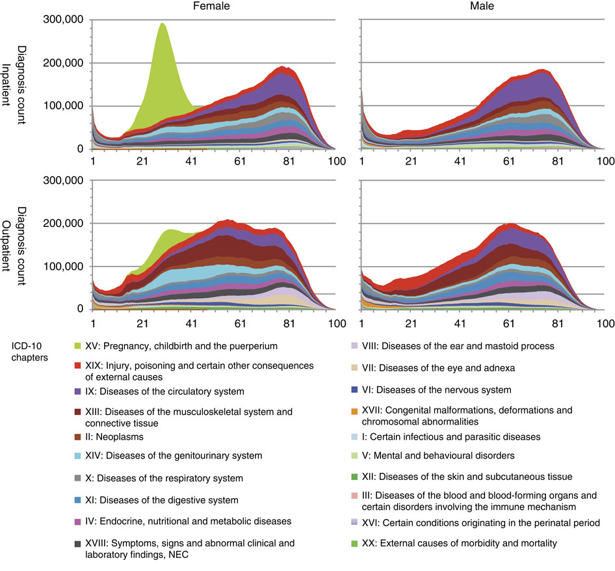
Case Study Danish Medical Data – Results

Slide 7
Case Study Danish Medical Data – Results

Slide 8
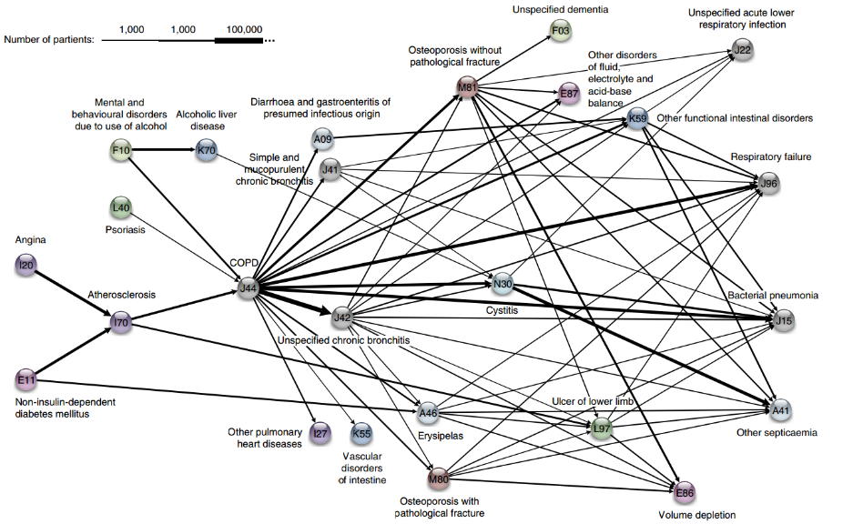
Case Study Danish Medical Data – Results (COPD)

Slide 9
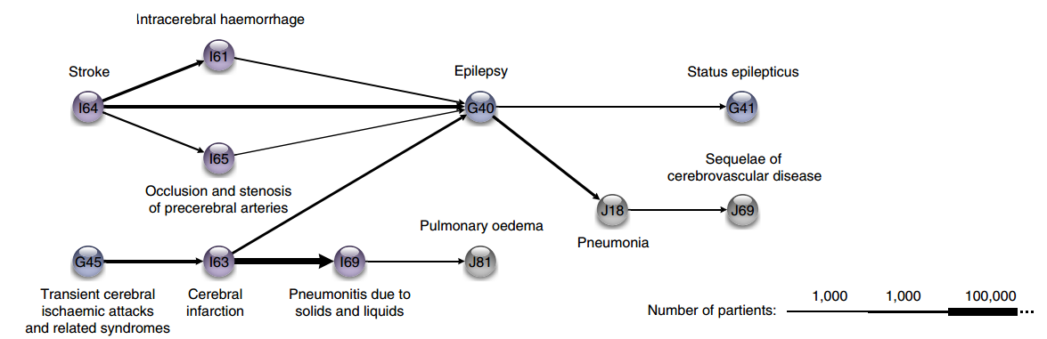
Case Study Danish Medical Data – Results (Cerebro-Vascular)

Slide 10
Case Study Danish Medical Data – Take-Aways
“Data analysis makes it possible to view diseases in a larger context,” A.B. Jensen
“The research could yield tangible health benefits as we move beyond one-size-fits-all medicine,” L.J. Jensen
“The sooner a health risk pattern is identified, the better we can prevent and treat critical diseases,” S. Brunak
“Instead of looking at each disease in isolation, you can talk about a complex system with many different interacting factors. By looking at the order in which different diseases appear, you can start to draw patterns and see complex correlations outlining the direction for each individual person,” L.J. Jensen

Slide 11
Contents Spotlight on Big Data
0. Big Data Q & A
1. What’s the Big Deal With Big Data?
Big Data vs. Small Data
Distributed Computing
2. Hardware Solutions
Cores, Clusters, Farms, Grids, and Clouds
Cost and Processing Power
3. Software Solutions
Selecting the Framework
The MapReduce Paradigm
MapReduce and Machine Learning Algorithms
An Introduction to Spark + H2O
4. Examples

Slide 12
Big Data Q & A

Slide 13
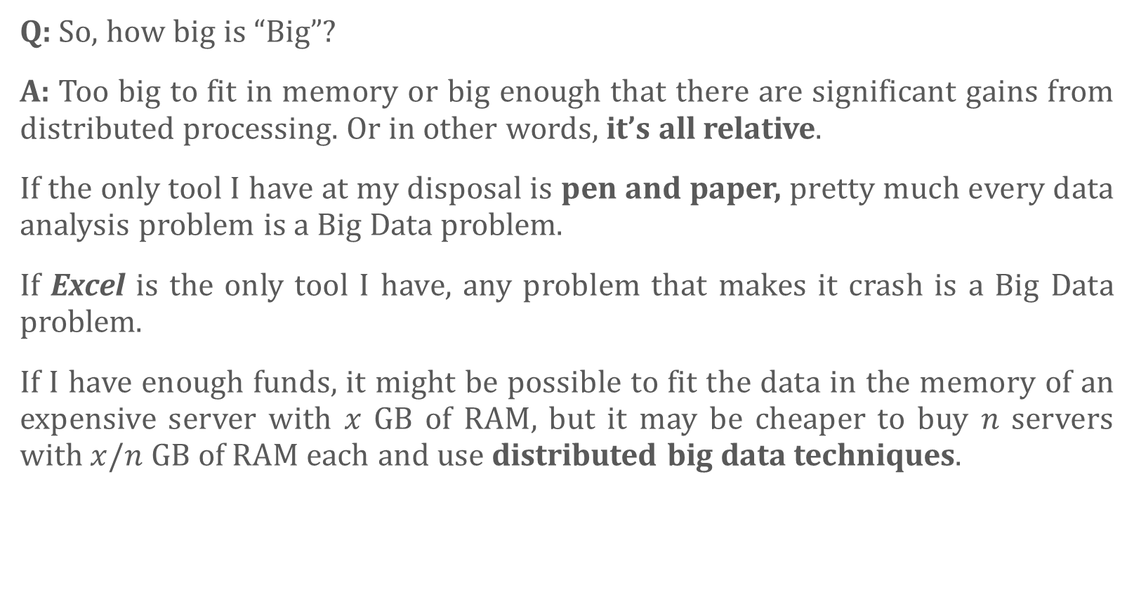
Big Data Q & A
Q: So, how big is “Big”?
A: Too big to fit in memory or big enough that there are significant gains from distributed processing. Or in other words, it’s all relative.
If the only tool I have at my disposal is pen and paper, pretty much every data analysis problem is a Big Data problem.
If Excel is the only tool I have, any problem that makes it crash is a Big Data problem.
If I have enough funds, it might be possible to fit the data in the memory of an expensive server with $x$ GB of RAM, but it may be cheaper to buy $n$ servers with $x/n$ GB of RAM each and use distributed big data techniques.

Slide 14
Big Data Q & A
Q: So I have to know parallel programming to analyze Big Data?
A: No, frameworks like Hadoop and Spark take care of the low-level details. You just have to understand how to use MapReduce.
We’ll talk about that in a bit.

Slide 15
Big Data Q & A
Q: You’re probably going to tell me that I need to know statistics to use Big Data, right?
A: It depends, actually. Solutions like PredictionIO (which uses Spark under the hood) make things pretty plug-and-play. You just need to know how to program. Other frameworks require you to do more.
But I’m not going to lie, you’re probably better off knowing about statistics and parallel computing instead of using data analysis tools blindly (never mind how big the data is!)

Slide 16
Big Data Q & A
Q: What's Hadoop?
A: I though you’d never ask. Hadoop is a software framework with a number of components which can be used separately or together. The components provide functionality for the various tasks required in distributed big data:
a cluster manager,
a MapReduce Application Program Interface (API),
a distributed file system (like network storage except hosted on a cluster)
etc.
Spark is newer than Hadoop and is generally considered to be an improvement, although it doesn't attempt to recreate and cover all of Hadoop’s functionality.

Slide 17
Big Data Q & A
Q: Hadoop and Spark sound very generic. They're described with phrases like "programming model", "distributed computing framework", "data abstraction", etc.. Does it take a lot of custom programming to do practical machine learning tasks?
A: It takes some, but you don't have to implement the machine learning algorithms yourself. They're available in libraries like Mahout and MLlib.

Slide 18
Big Data as Panacea A Word of Warning
Big Data is no crystal ball
Collected data can only come from the past
Analyzing data may provide a link between actions and consequences, which can be used to predict the future ... if trends continue
“Past performance does not guarantee future results”
Big Data can't dictate personal or organizational values
The right value answer may be the wrong data science answer
Data-based conclusions do not live in a vacuum: context matters
Blind obedience to data-driven results is just as dangerous as rejection based on gut-reaction
Big Data can't solve every problem
“When all you have is a hammer, everything looks like a nail”
Large number of distinct problems out there; not all of them call for Big Data techniques

Slide 19
Preach It, Brother!
With too little data, you won't be able to reach any conclusions that you can trust. With loads of data you will find relationships that aren't real... Big data isn't about bytes, its about talent.
– Douglas Merrill

Slide 20
What’s the Big Deal With Big Data?

Slide 21
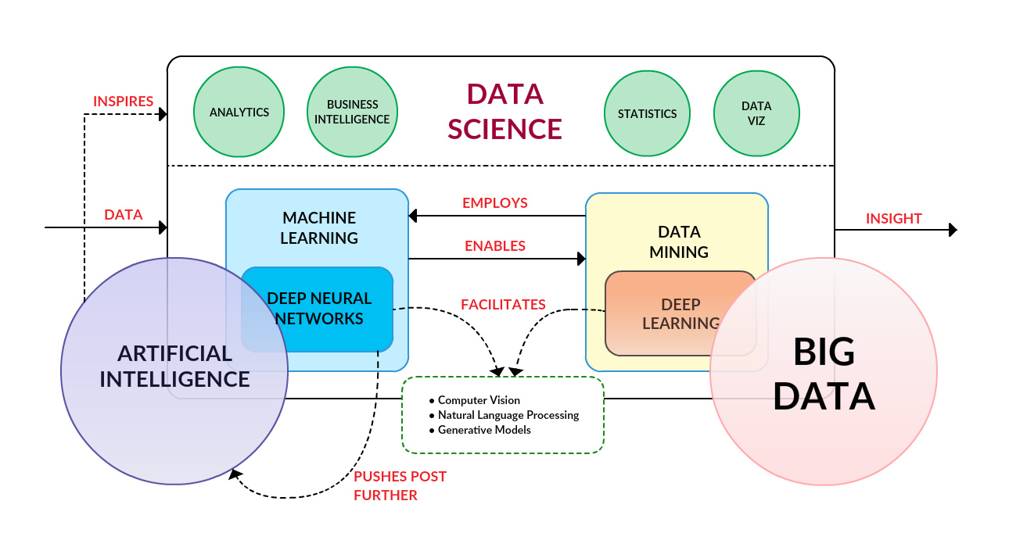
What’s the Big Deal With Big Data? Big Data in the Analytics Landscape
[Matthew Mayo, KDNuggets.com]

Slide 22
What’s the Big Deal With Big Data Big Data in the CQADS Landscape
problem-solving
quantitative problem-solving
statistical problem-solving
data science problem-solving
big data problem-solving

Slide 23
Contents Spotlight on Big Data
0. Big Data Q & A
1. What’s the Big Deal With Big Data?
Big Data vs. Small Data
Distributed Computing
2. Hardware Solutions
Cores, Clusters, Farms, Grids, and Clouds
Cost and Processing Power
3. Software Solutions
Selecting the Framework
The MapReduce Paradigm
MapReduce and Machine Learning Algorithms
An Introduction to Spark + H2O
4. Examples

Slide 24
What’s The Big Deal With Big Data? Big Data vs. Small Data
What is the main difference?
The datasets are LARGE
New challenges: collection, capture, access, storage, analysis and visualization
Where does the data come from?
Technology advances are lifting the limits on data processing speeds
Information-sensing, mobile devices, cameras and wireless networks
Genomics, transaction, sensors, social media, geographical and environmental data, etc.
What are the challenges?
Most techniques were built around very small dataset
Direct approach will leave the best analyst waiting years for results

Slide 25
What’s The Big Deal With Big Data? Big Data vs. Small Data – The 5-V Paradigm
Volume
Large amounts of data
Velocity
Speed at which data is created
Speed at which it can be accessed and processed
Variety
Different types of available data
Can’t all be saved in relational databases (tables, pictures, conversations,…)
Veracity
Quality and accuracy of big data is harder to control; nevertheless analyzable
Value
Ultimate goal: turn the data into something useful
Variability
Visualization

Slide 26
Contents Spotlight on Big Data
0. Big Data Q & A
1. What’s the Big Deal With Big Data?
Big Data vs. Small Data
Distributed Computing
2. Hardware Solutions
Cores, Clusters, Farms, Grids, and Clouds
Cost and Processing Power
3. Software Solutions
Selecting the Framework
The MapReduce Paradigm
MapReduce and Machine Learning Algorithms
An Introduction to Spark + H2O
4. Examples

Slide 27
What’s The Big Deal With Big Data? Distributed Computing
Many computations happen instantly, others take a significant amount of time.
Crunching very large datasets is a perfect example. Try doing some analysis in R or Python while steadily increasing the size of the data. What happens?
Soon your computer will start to lag. Eventually, the time required to complete the computations will become impractically long.
Optimizing your code and using a faster CPU can only get you so far. Moore's Law has ‘tapered off’ for CPU clock speeds (inasmuch as it ever applied in the first place, which it probably didn’t).
This is the big data problem.

Slide 28
What’s The Big Deal With Big Data? Distributed Computing
What if you could split your computation among multiple CPU cores, multiple CPUs, or multiple computers and divide the computation time by a factor of 4, or 32, or 1000?
These factors can allow you to run algorithms on big data that keep your analytics/recommendations/smart services updated daily, hourly, or even in real time.
Election analogy to parallelization:
counting votes at different polling stations in a riding
each station simultaneously counts its own votes and reports their total
the totals of all polling stations are aggregated at Elections HQ
one person counting all the ballots would eventually get the same result (assuming that they haven’t made a mistake), but it would take forever to get the result.

Slide 29












What’s The Big Deal With Big Data? Distributed Computing – Election Analogy
6752
230
198
228
…
230
112
75
9001
112
123
144
…
198
123
201
…
…
…
…
228
144
212
75
201
212
11793

Slide 30
What’s The Big Deal With Big Data? Distributed Computing
The gains from parallelism depend on whether serial algorithms can be adapted to make use of parallel hardware.
Pizzeria analogy for limitations of parallelization/bottleneck:
multiple cooks can prepare toppings in parallel
but baking the crust can't be parallelized
doubling oven space will increase the number of pizzas that can be made simultaneously but won't substantially speed up any one pizza
sometimes bottlenecks prevent any gains from parallelism: people line up on both sides of a table to get some soup but there's only one ladle
Good news: most practical computational tasks can be and are parallelized.
"Unparallelized applications leave significant performance on the table for current processors.“ [McCool, Robison, Reinders, 2012]

Slide 31
Hardware Solutions

Slide 32
Contents Spotlight on Big Data
0. Big Data Q & A
1. What’s the Big Deal With Big Data?
Big Data vs. Small Data
Distributed Computing
2. Hardware Solutions
Cores, Clusters, Farms, Grids, and Clouds
Cost and Processing Power
3. Software Solutions
Selecting the Framework
The MapReduce Paradigm
MapReduce and Machine Learning Algorithms
An Introduction to Spark + H2O
4. Examples

Slide 33
Hardware Solutions Cores, Clusters, Farms, Grids, and Clouds
Let’s look at some hardware configurations for parallelism:
Multi-core processor:
computers equipped with these have the ability to run as many parallel processes as there are cores
as of Jan 2017, Intel offers processors marketed for gaming with 10 cores (1725USD), and server processors with 72 cores (6254USD)
most modern laptops and desktop computers have multi-core processors
hyperthreading is not fully independent parallel hardware
Less commonly, computers may have multiple processors, each of which may have multiple cores (Sunway TaihuLight supercomputer had 40k processors and 10m cores in 2017, for instance)

Slide 34
Hardware Solutions Cores, Clusters, Farms, Grids, and Clouds
Distributed computing: parallelism achieved by involving multiple computers networked together
Cluster:
a set of computers, generally in the same physical location and on the same LAN, often with the exact same hardware configuration
some tasks are divided and performed in parallel on these computers
also known as a farm
hardware costs determine whether it is cheaper to have many computers with few cores each or few computers with many cores each

Slide 35
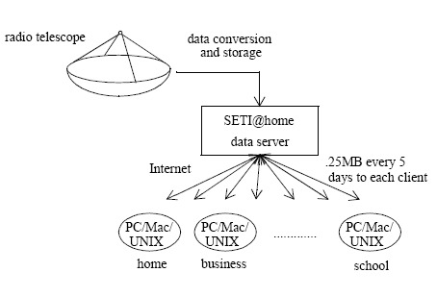
Hardware Solutions Cores, Clusters, Farms, Grids, and Clouds
Grid:
also a set of computers which work on parallelized tasks
not necessarily on the same network, or in the same location, or running the same hardware
Example: the SETI@home project allows you to add your computer to an international grid which analyzes radio telescope data for proof of intelligent life

Slide 36
Hardware Solutions Cores, Clusters, Farms, Grids, and Clouds
Cloud:
the word has become vague due to overuse as a buzzword
the most useful meaning is a datacenter (or set of datacenters) to which you can rent access via scalable virtual machines
each customer is given the use of a virtual machine (VM) with configurable resources
the hardware running the VMs is completely “abstract” to the user
clouds can be used for doing any kind of computation, parallel or otherwise
Assuming you want access to parallel hardware beyond your own computer's cores, you have two choices:
a (local) cluster
a (virtual) cloud cluster, such as the Amazon Elastic MapReduce service

Slide 37
Contents Spotlight on Big Data
0. Big Data Q & A
1. What’s the Big Deal With Big Data?
Big Data vs. Small Data
Distributed Computing
2. Hardware Solutions
Cores, Clusters, Farms, Grids, and Clouds
Cost and Processing Power
3. Software Solutions
Selecting the Framework
The MapReduce Paradigm
MapReduce and Machine Learning Algorithms
An Introduction to Spark + H2O
4. Examples

Slide 38
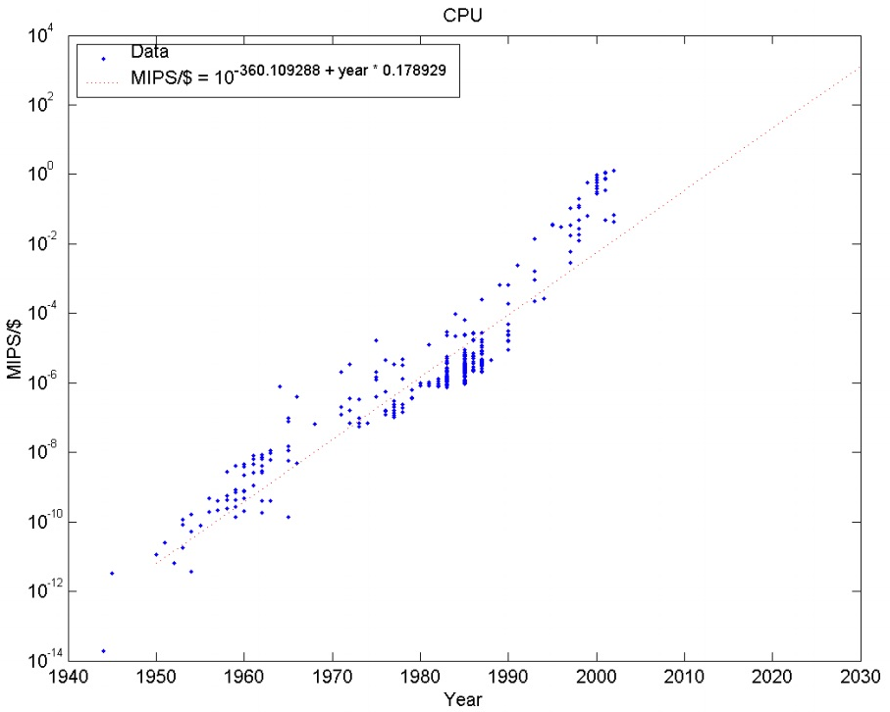
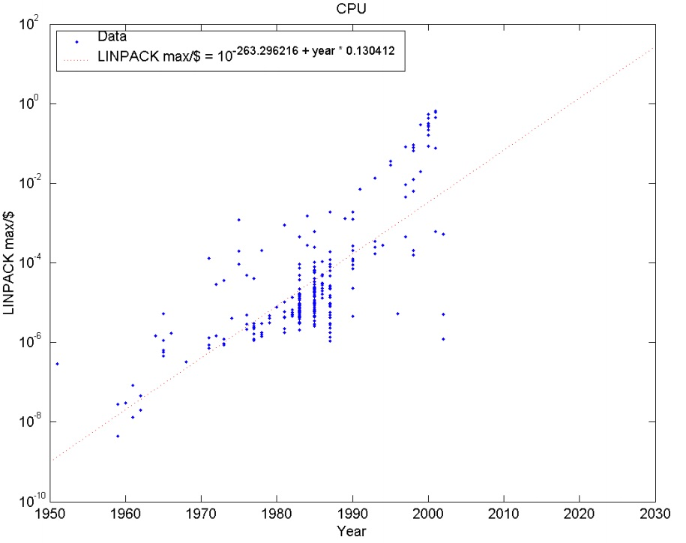

Hardware Solutions Cost and Processing Power
MIPS$=$ millions of instructions per second
FLOPS$=$ floating point operations per second (more relevant for numerical computations).
[Katja Grace, Trends in the Cost of Computing, AIImpacts.com]

Slide 39
Hardware Solutions Cost and Processing Power
MIPS/$ has grown at a factor of 10 every 5 years or so since 1940, FLOPS/$ every 8 years or so.
Thus if you measure total capacity of a cluster by MIPS (which basically assumes you can parallelize with 100% efficiency), every five years the computational power of a cluster you can buy for say $1000 multiplies by 10.
This is essentially the solution to the big data problem: throw money at the problem and/or wait.
The only issue remaining is getting software to fully utilize the hardware

Slide 40
Software Solutions

Slide 41
Software Solutions R and Big Data
R was not specifically designed to work with big data (keeps all objects in RAM)
But there's a strong push to use R for big data: some adaptations include
Revolution Analytics: R Enterprise, RHadoop
R packages designed to keep objects in storage, not RAM (ff package)
R integrations with other languages that can do memory management and batching (RJava, RCPP)
Faster data processing strategies, such as using a different interpreter (e.g. pqR)
pbdR (programming big data in R) project [http://www.r-pbd.org]
SparkR
Other tools: MapReduce, Spark, Hadoop, H2O

Slide 42
Contents Spotlight on Big Data
0. Big Data Q & A
1. What’s the Big Deal With Big Data?
Big Data vs. Small Data
Distributed Computing
2. Hardware Solutions
Cores, Clusters, Farms, Grids, and Clouds
Cost and Processing Power
3. Software Solutions
Selecting the Framework
The MapReduce Paradigm
MapReduce and Machine Learning Algorithms
An Introduction to Spark + H2O
4. Examples

Slide 43
Software Solutions Selecting the Framework
The big data problem (reprise):
You want to analyze a dataset but it's too big to fit in memory
and/or
You want to analyze a dataset and save time by utilizing multiple CPU cores
Solution:
select a hardware solution
break the data into small pieces
process the pieces in parallel through various CPU cores
aggregate the results on the master core/node

Slide 44
Software Solutions Selecting the Framework
Frameworks do the low-level work of coordinating CPUs in a cluster and managing memory.
On top of a framework for generic distributed computing, there is generally a library available which implements a range of machine learning methods.
Putting these two pieces together, we get a machine learning platform that uses distributed processing while staying user-friendly
We will focus on frameworks (Spark and H2O+R) that:
support Python and/or R (and other languages)
have a machine learning library
can be installed on your own hardware

Slide 45
Contents Spotlight on Big Data
0. Big Data Q & A
1. What’s the Big Deal With Big Data?
Big Data vs. Small Data
Distributed Computing
2. Hardware Solutions
Cores, Clusters, Farms, Grids, and Clouds
Cost and Processing Power
3. Software Solutions
Selecting the Framework
The MapReduce Paradigm
MapReduce and Machine Learning Algorithms
An Introduction to Spark + H2O
4. Examples

Slide 46
Software Solutions The MapReduce Paradigm – Introduction
The most important concept needed is the MapReduce paradigm
It operates on a function mapper, a function reducer, and a dataset data in the form of a list
1. The map operation is performed with mapper on data mapped = map(mapper,data)
The map operation simply applies a function to each element in a list and returns the list of results: map(f,[a,b,c,d,e,…]) = [f(a),f(b),f(c),f(d),f(e),…]
It processes each element independently of one another.

Slide 47
Software Solutions The MapReduce Paradigm – Introduction
The mapper returns a key-value pair (an ordered pair of objects). The variable mapped looks like this mapped = [ (mapper(data[0])[0],mapper(data[0])[1]), (mapper(data[1])[0],mapper(data[1])[1]), … ]
2. MapReduce groups together all the key-value pairs in mapped by key, and generates a new list of key-value pairs (key,[value1,value2,…])
where key is some key from mapped and value1,value2,… are all the values associated with key in mapped (including repeats).
Call this new list grouped = group(mapped)

Slide 48
Software Solutions The MapReduce Paradigm – Introduction
Example: If we have mapped = [('𝚉𝙽𝙵',2),('𝙶𝙿𝚁',0),('𝚉𝙽𝙵',6),('𝚃𝙼𝙴𝙼',9),('𝙲𝙲𝙳𝙲',1)]
then grouped = [('𝙲𝙲𝙳𝙲',[1]),('𝙶𝙿𝚁',[0]),('𝚃𝙼𝙴𝙼',[9]),('𝚉𝙽𝙵',[2,6])]
3. MapReduce generates a list reduced by taking grouped and applying reducer to each key list with the reduce operation.
The reduce operation takes a function reducer with two arguments and goes through a list applying it on each element, together with the result of the previous reducer call. reduce(f,[a,b,c,d,…])=f(f(f(f(a,b),c),d),…)
It skips the first entry a and uses it as the "previous result" when processing the second entry b. The end result is a single value.

Slide 49
Software Solutions The MapReduce Paradigm – Introduction
Example: If add(x,y)=x+y, then we have reduce(add,[a,b,c,d]) = add(add(add(a,b),c),d) = add(add(a+b,c),d) = add(a+b+c,d) = a+b+c+d
The end result looks like mapReduce(mapper,reducer,data) = reduced = reduce(reducer,grouped) = reduce(reducer,group(mapped)) = reduce(reducer,group(map(mapper,data))) = [ (key1, list1), (key2, list2), … ]
where key1,key2,… are the distinct keys from mapped and list1,list2,… are the associated list of reduced values

Slide 50
Software Solutions The MapReduce Paradigm – Canonical Example
The canonical example for MapReduce (invented by Google) is word counting:
Given a text split up into a list of individual words (including repeats), what is the number of occurrences of each word?
Remember, MapReduce requires a mapper function, a reducer function, and a data list.
Example: consider the list words = ['big','big','big','big','data'] with the functions mapper(x) = (x, 1) reducer = add

Slide 51
Software Solutions The MapReduce Paradigm – Canonical Example
1. The mapper function associates each instance of a word with the value 1: mapped = map(mapper,words) = [('big',1),('big',1),('big',1),('big',1),('data',1)]
2. All values with the same key are grouped together: grouped = group(mapped) = [('big',[1,1,1,1]),('data',[1])]
3. The add function adds up the values in a list: reduced = reduce(add,grouped) = [('big',4),('data',1)]

Slide 52
Software Solutions The MapReduce Paradigm – Parallelization
As long as the mapper and reducer functions are free of side-effects (i.e. they don't modify global states), it’s possible to use implemented MapReduce algorithms to automatically distribute the operation over a cluster:
map can operate on different data elements in parallel
as long as reducer is associative and commutative, reduce can also operate in parallel on chunks of data, and be called again on the intermediate results.
The final result is equivalent to calling reduce on the whole set.

Slide 53
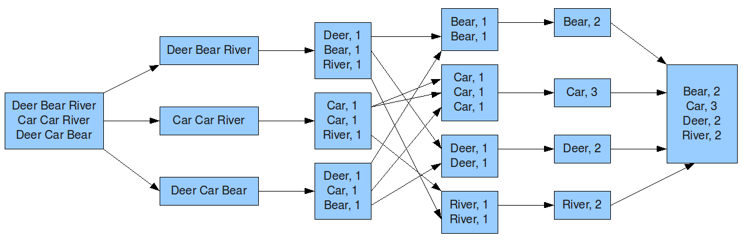
Software Solutions The MapReduce Paradigm – Canonical Example (Revisited)
Input
Splitting
Mapping
Grouping
Reducing
Final
[Unknown author]

Slide 54
Contents Spotlight on Big Data
0. Big Data Q & A
1. What’s the Big Deal With Big Data?
Big Data vs. Small Data
Distributed Computing
2. Hardware Solutions
Cores, Clusters, Farms, Grids, and Clouds
Cost and Processing Power
3. Software Solutions
Selecting the Framework
The MapReduce Paradigm
MapReduce and Machine Learning Algorithms
An Introduction to Spark + H2O
4. Examples

Slide 55
Software Solutions MapReduce and Machine Learning Algorithms
Let’s take a look at some machine learning methods and see how we would approach them using MapReduce:
multinomial naïve Bayes (classification)
k-means (clustering)
streaming k-means (clustering)
These methods are already implemented in big data frameworks such as MLlib, but we get a deeper understanding of MapReduce by understanding how it is used to allow algorithms to be parallelized.

Slide 56
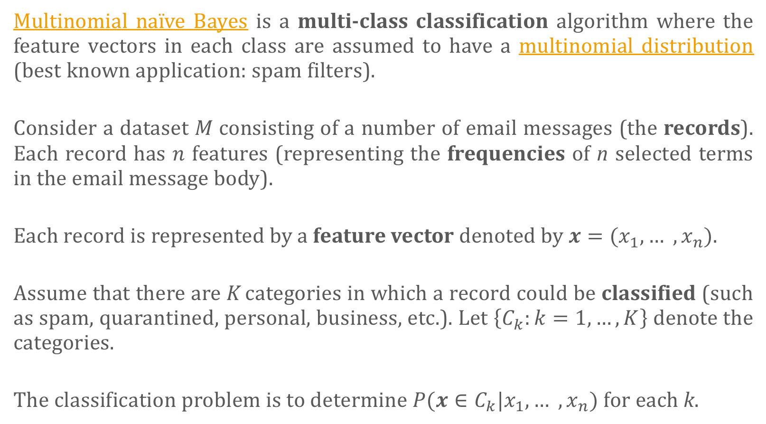
Software Solutions MapReduce and Machine Learning Algorithms – Naïve Bayes
Multinomial naïve Bayes is a multi-class classification algorithm where the feature vectors in each class are assumed to have a multinomial distribution (best known application: spam filters).
Consider a dataset $M$consisting of a number of email messages (the records). Each record has $n$ features (representing the frequencies of n selected terms in the email message body).
Each record is represented by a feature vector denoted by $x=(x_{1}, … ,x_{n})$.
Assume that there are K categories in which a record could be classified (such as spam, quarantined, personal, business, etc.). Let $\left\{C_{k}:k=1,…,K\right\}$ denote the categories.
The classification problem is to determine $P(x∈C_{k}$|$x_{1}, … ,x_{n})$ for each k.

Slide 57
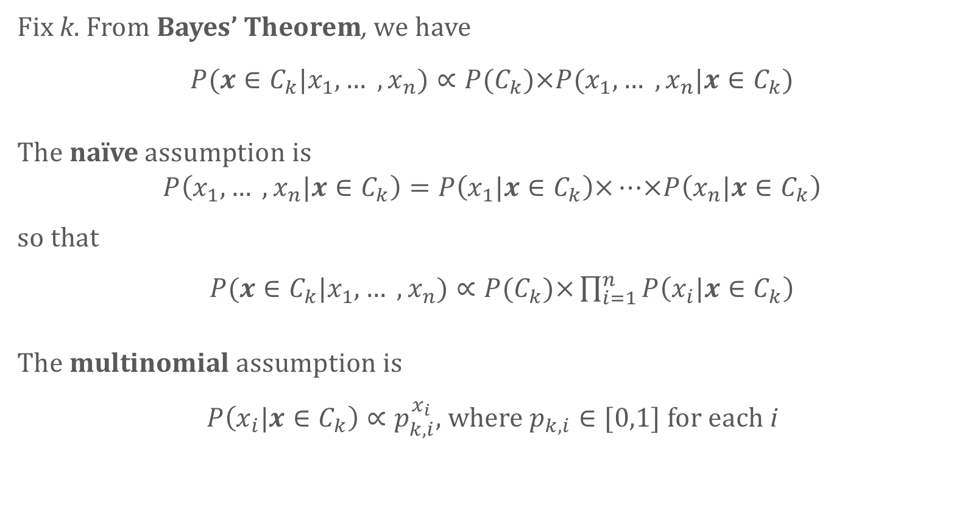
Software Solutions MapReduce and Machine Learning Algorithms – Naïve Bayes
Fix k. From Bayes’ Theorem, we have
$P(x∈C_{k}$|$x_{1}, … ,x_{n})∝P(C_{k})×P(x_{1}, … ,x_{n}\text{|}x∈C_{k})$
The naïve assumption is
$$P\left(x_{1}, … ,x_{n}\text{|}x∈C_{k}\right)=P\left(x_{1}\text{|}x∈C_{k}\right)×…×P\left(x_{n}\text{|}x∈C_{k}\right)$$ so that
$P(x∈C_{k}$|$x_{1}, … ,x_{n})∝P(C_{k})×\prod_{i=1}^{n}{P\left(x_{i}\text{|}x∈C_{k}\right)}$
The multinomial assumption is
$P\left(x_{i}\text{|}x∈C_{k}\right)∝p_{k,i}^{x_{i}}$, where $p_{k,i}∈[0,1]$ for each i

Slide 58
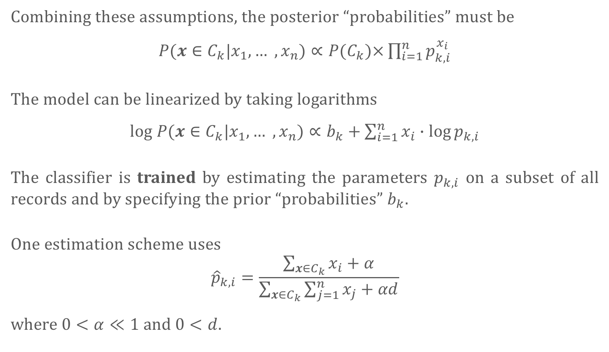
Software Solutions MapReduce and Machine Learning Algorithms – Naïve Bayes
Combining these assumptions, the posterior “probabilities” must be
$P(x∈C_{k}$|$x_{1}, … ,x_{n})∝P(C_{k})×\prod_{i=1}^{n}{p_{k,i}^{x_{i}}}$
The model can be linearized by taking logarithms
log $P(x∈C_{k}$|$x_{1}, … ,x_{n})∝b_{k}+\sum_{i=1}^{n}{x_{i}∙\log{p_{k,i}}}$
The classifier is trained by estimating the parameters $p_{k,i}$ on a subset of all records and by specifying the prior “probabilities” $b_{k}$.
One estimation scheme uses
$${\hat{p}}_{k,i}=\frac{\sum_{x∈C_{k}}{x_{i}}+α}{\sum_{x∈C_{k}}{\sum_{j=1}^{n}{x_{j}+αd}}}$$
where $0<α≪1$ and $0<d$.

Slide 59
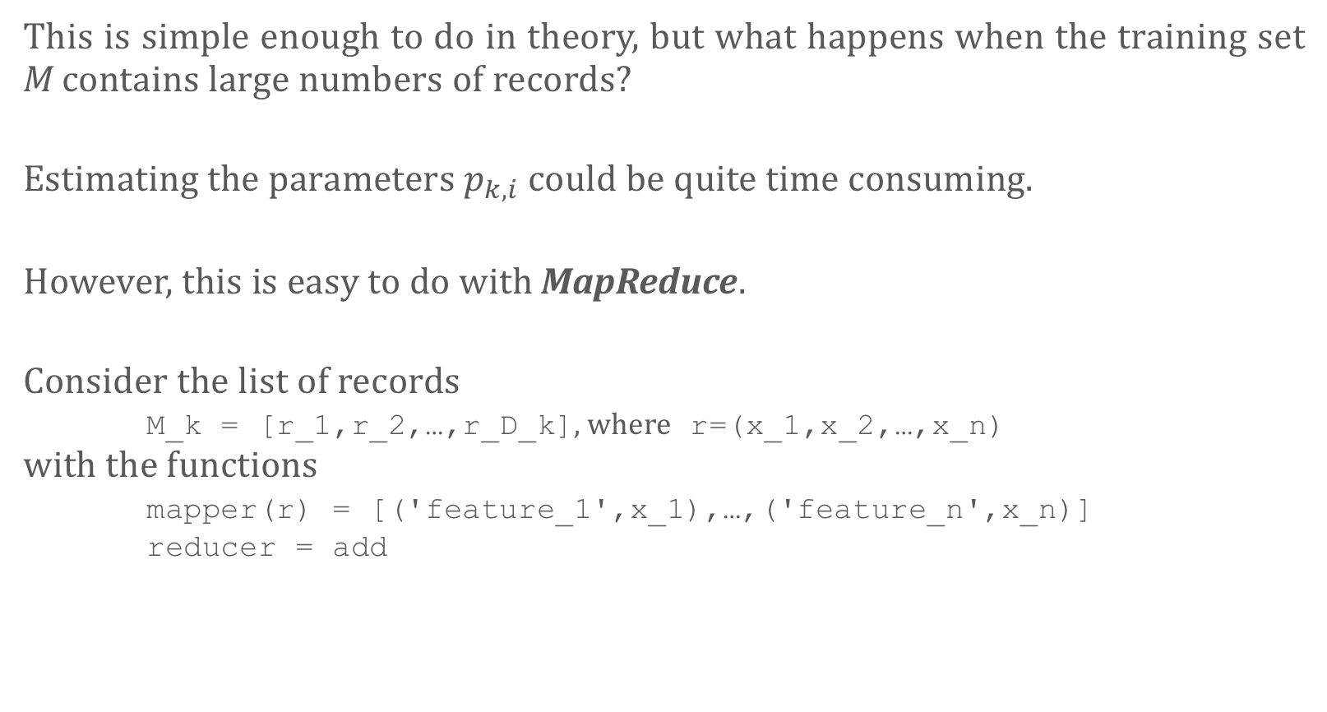
Software Solutions MapReduce and Machine Learning Algorithms – Naïve Bayes
This is simple enough to do in theory, but what happens when the training set M contains large numbers of records?
Estimating the parameters $p_{k,i}$ could be quite time consuming.
However, this is easy to do with MapReduce.
Consider the list of records M_k = [r_1,r_2,…,r_D_k], where r=(x_1,x_2,…,x_n) with the functions mapper(r) = [('feature_1',x_1),…,('feature_n',x_n)] reducer = add

Slide 60
Software Solutions MapReduce and Machine Learning Algorithms – Naïve Bayes
1. The mapper function associates each observation’s features with its values: mapped = map(mapper,M_k) = [('feature_1',x_r_1_1),…,('feature_n',x_r_1_n), ('feature_1',x_r_2_1),…,('feature_n',x_r_2_n),…, ('feature_1',x_r_D_k_1),…,('feature_n',x_r_D_k_n)]
2. All values with the same key are grouped together: grouped = group(mapped) = [('feature_1',[x_r_1_1,…,x_r_D_k_1]),…, ('feature_n',[x_r_1_n,…,x_r_D_k_n])]
3. The add function adds up the values in a list: reduced = reduce(add,grouped) = [('feature_1',x_r_1_1+…+x_r_D_k_1),…, ('feature_n',x_r_1_n+…+x_r_D_k_n)]

Slide 61
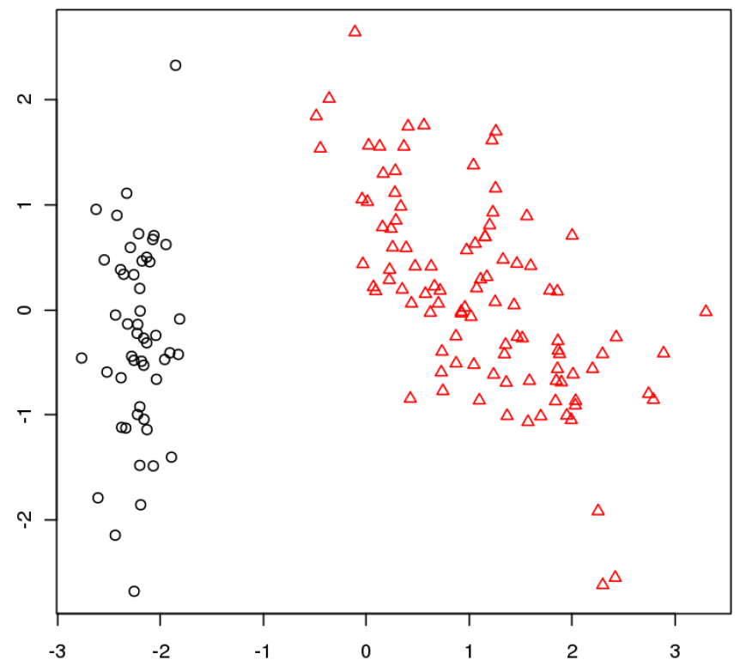

Software Solutions MapReduce and Machine Learning Algorithms – $k$-Means
k-means is a machine learning algorithm which clusters data points.
Objective: partition the data points into subsets in such a way that each point has more in common with the other elements in its cluster than with the elements in other clusters.

Slide 62
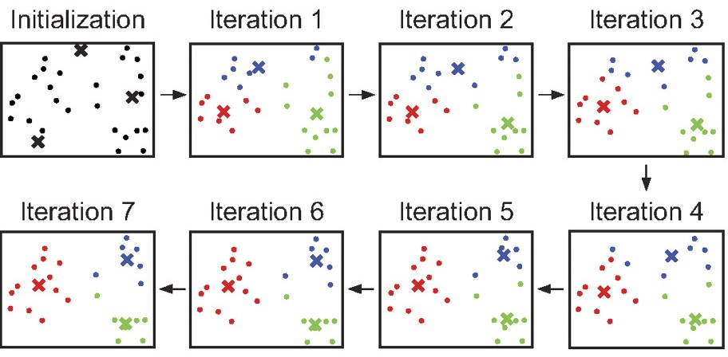
Software Solutions MapReduce and Machine Learning Algorithms – $k$-Means
In the k-means setting, the goal is to find clusters which minimize the average Euclidean distance between two points in the same cluster.
The algorithm works in two steps: initialization and iterations.
Each cluster is determined by a "centre" (which need not be a data point)
The cluster’s points are the ones closer to its center than any other center.
During initialization, a set of k centres are chosen from the data points, after which the centres are revised by a number of iteration steps.

Slide 63
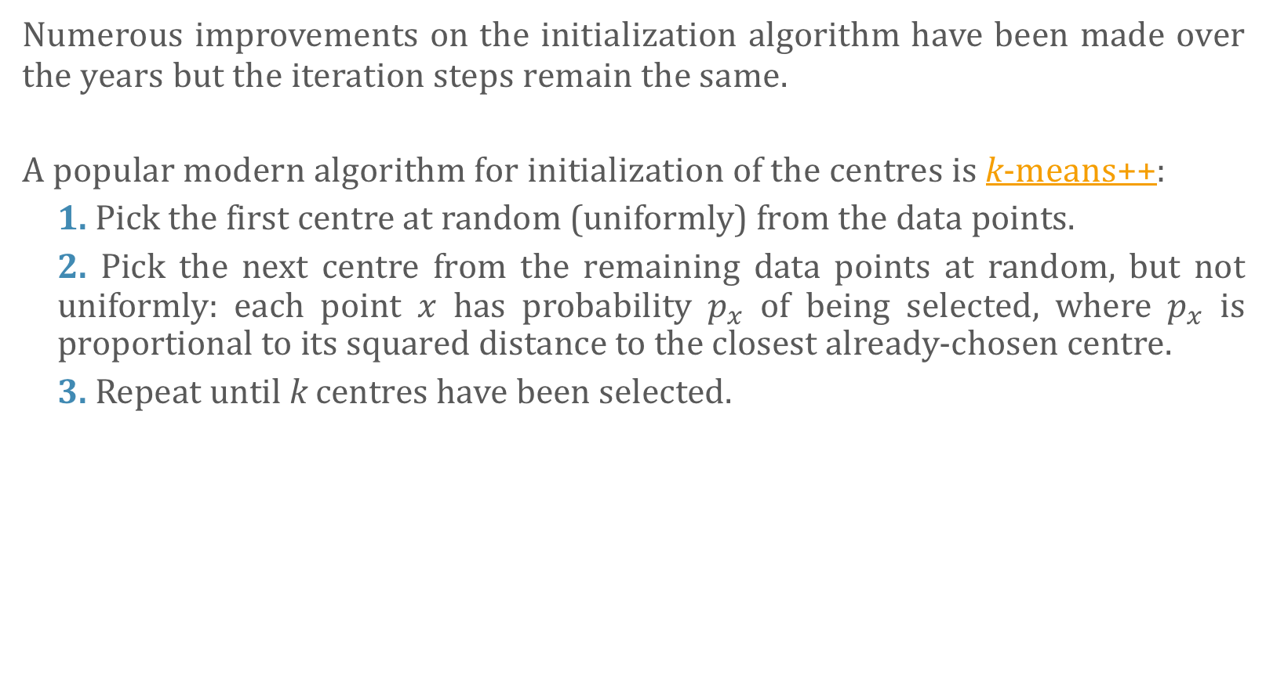
Software Solutions MapReduce and Machine Learning Algorithms – $k$-Means
Numerous improvements on the initialization algorithm have been made over the years but the iteration steps remain the same.
A popular modern algorithm for initialization of the centres is k-means++:
1. Pick the first centre at random (uniformly) from the data points.
2. Pick the next centre from the remaining data points at random, but not uniformly: each point $x$ has probability $p_{x}$ of being selected, where $p_{x}$ is proportional to its squared distance to the closest already-chosen centre.
3. Repeat until k centres have been selected.

Slide 64
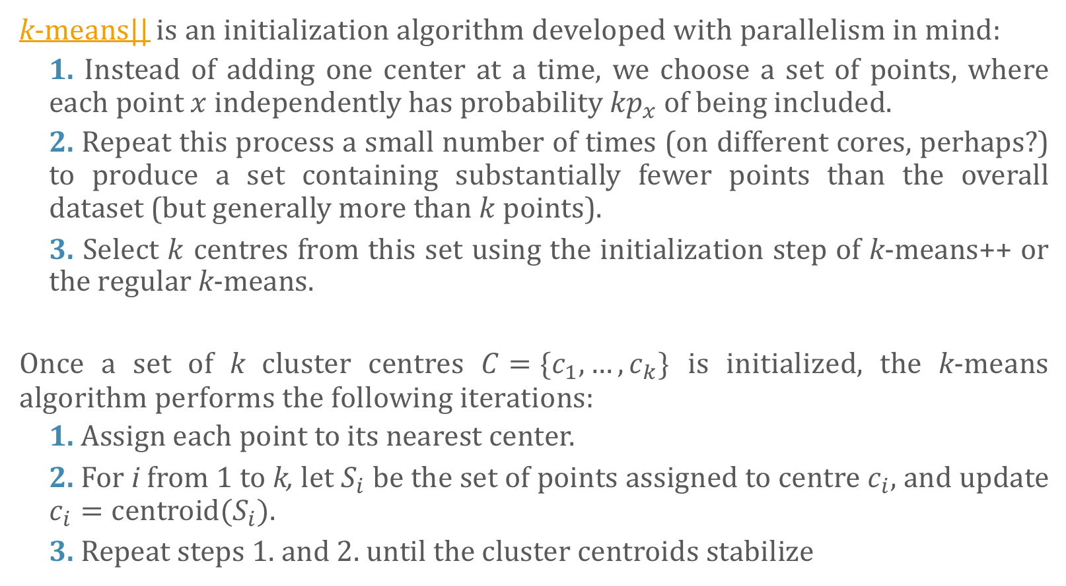
Software Solutions MapReduce and Machine Learning Algorithms – $k$-Means
k-means|| is an initialization algorithm developed with parallelism in mind:
1. Instead of adding one center at a time, we choose a set of points, where each point $x$ independently has probability ${kp}_{x}$ of being included.
2. Repeat this process a small number of times (on different cores, perhaps?) to produce a set containing substantially fewer points than the overall dataset (but generally more than $k$ points).
3. Select $k$ centres from this set using the initialization step of k-means++ or the regular k-means.
Once a set of k cluster centres $C=\{c_{1},…, c_{k}\}$ is initialized, the k-means algorithm performs the following iterations:
1. Assign each point to its nearest center.
2. For i from 1 to k, let $S_{i}$ be the set of points assigned to centre $c_{i}$, and update $c_{i}=\text{centroid}(S_{i})$.
3. Repeat steps 1. and 2. until the cluster centroids stabilize

Slide 65

Software Solutions MapReduce and Machine Learning Algorithms – $k$-Means
This can be done in MapReduce.
Consider the list of points data = [x1,x2,…,xN] with the functions mapper(x) = (argmin_j[d(x,c_j)],x), where $c_{j}$ are the centroids. reducer = [add,length]
The set C of centroids is small and can be saved to a global variable.

Slide 66
Software Solutions MapReduce and Machine Learning Algorithms – $k$-Means
1. The mapper function associates each observation with the closest centroid: mapped = map(mapper,data) = [(i_x1,x1),…,(i_xN,xN)]
2. All values with the same key are grouped together (requires re-labeling): grouped = group(mapped) = [(i_1,[x_1_1,…,x_1_N1]),…,(i_k,[x_k_1,…,x_k_Nk])]
3. The reducer function finds values with which to compute the updated centroids: reduced = reduce([add,length],grouped) = [(i_1,add(x_1_1,…,x_1_N1),length(x_1_1,…,x_1_N1)),…, (i_k,add(x_k_1,…,x_k_Nk),length(x_k_1,…,x_k_Nk))] = [(i_1,x_1_1+…+x_1_N1,N1),…,(i_k,x_k_1+…+x_k_Nk,Nk)]

Slide 67
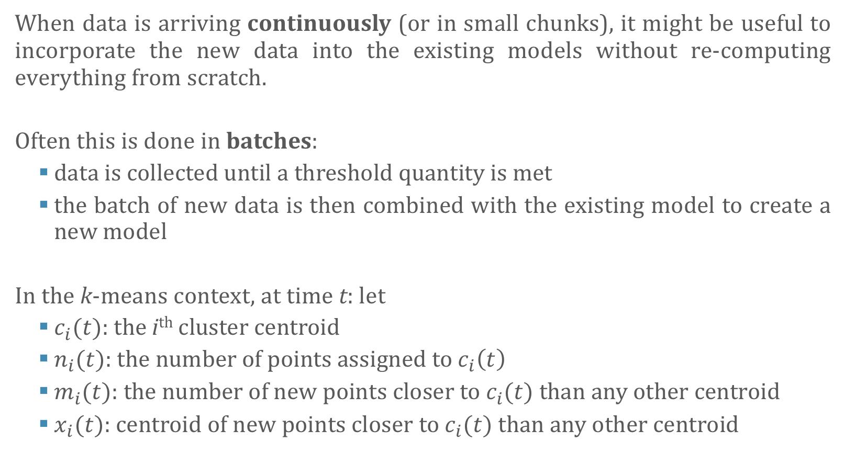
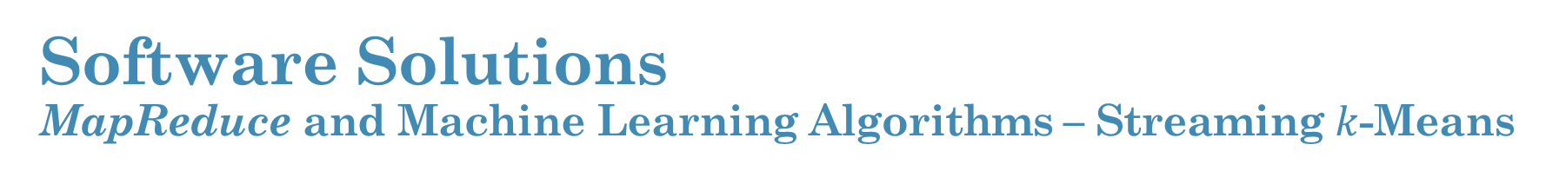
Software Solutions MapReduce and Machine Learning Algorithms – Streaming $k$-Means
When data is arriving continuously (or in small chunks), it might be useful to incorporate the new data into the existing models without re-computing everything from scratch.
Often this is done in batches:
data is collected until a threshold quantity is met
the batch of new data is then combined with the existing model to create a new model
In the k-means context, at time t: let
$c_{i}(t)$: the i^{th} cluster centroid
$n_{i}(t)$: the number of points assigned to $c_{i}\left(t\right)$
$m_{i}(t)$: the number of new points closer to $c_{i}(t)$ than any other centroid
$x_{i}(t)$: centroid of new points closer to $c_{i}(t)$ than any other centroid

Slide 68
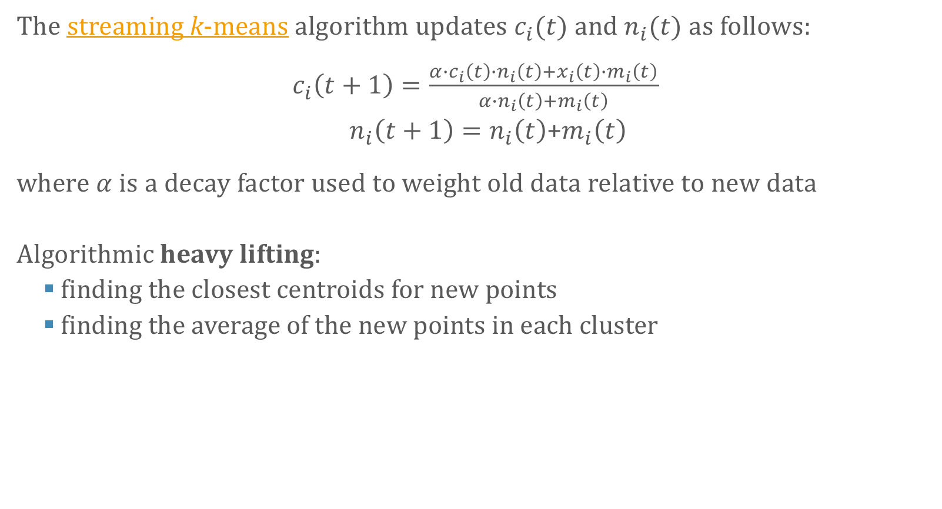
Software Solutions MapReduce and Machine Learning Algorithms – Streaming $k$-Means
The streaming k-means algorithm updates $c_{i}(t)$ and $n_{i}(t)$ as follows:
$c_{i}\left(t+1\right)=\frac{{α∙c}_{i}\left(t\right){∙n}_{i}\left(t\right)+x_{i}\left(t\right){∙m}_{i}\left(t\right)}{α{∙n}_{i}\left(t\right)+m_{i}\left(t\right)}$
$n_{i}\left(t+1\right)=n_{i}\left(t\right)$+$m_{i}\left(t\right)$
where $α$ is a decay factor used to weight old data relative to new data
Algorithmic heavy lifting:
finding the closest centroids for new points
finding the average of the new points in each cluster

Slide 69
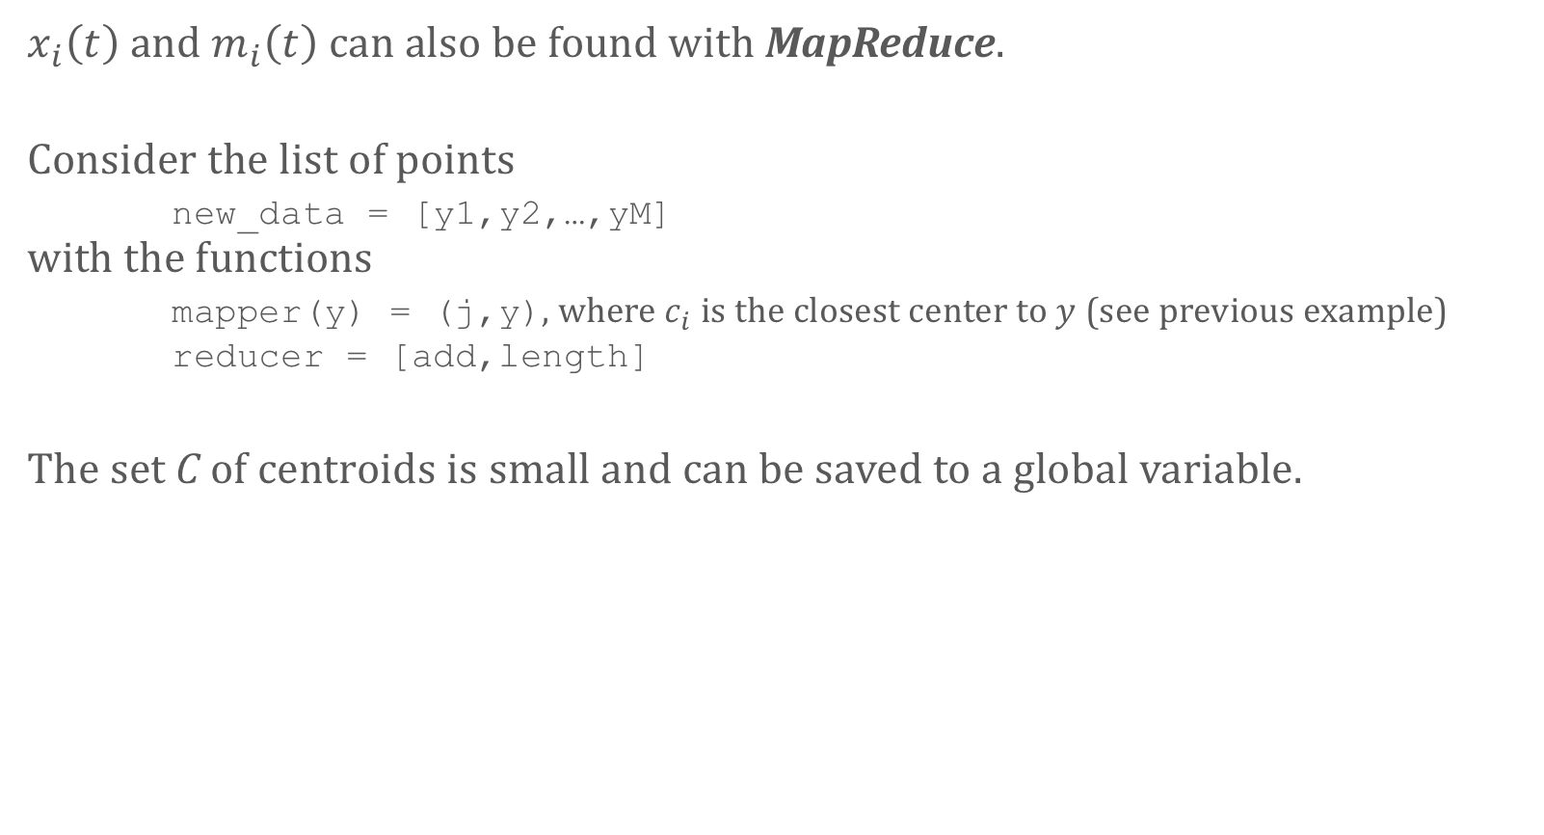
Software Solutions MapReduce and Machine Learning Algorithms – Streaming $k$-Means
$x_{i}\left(t\right)$ and $m_{i}\left(t\right)$ can also be found with MapReduce.
Consider the list of points new_data = [y1,y2,…,yM] with the functions mapper(y) = (j,y), where $c_{i}$ is the closest center to $y$ (see previous example) reducer = [add,length]
The set C of centroids is small and can be saved to a global variable.

Slide 70

Software Solutions MapReduce and Machine Learning Algorithms – Streaming $k$-Means
1. The mapper function associates each observation with the closest centroid: mapped = map(mapper,new_data) = [(i_y1,y1),…,(i_yM,yM)]
2. All values with the same key are grouped together (requires re-labeling): grouped = group(mapped) = [(i_1,[y_1_1,…,y_1_M1]),…,(i_k,[y_k_1,…,y_k_Mk])]
3. The reducer function finds values with which to compute the updated centroids: reduced = reduce([add,length],grouped) = [(i_1,[add(y_1_1,…,y_1_M1),length(y_1_1,…,y_1_M1)]),…, (i_k,[add(y_k_1,…,y_k_Mk),length(y_k_1,…,y_k_Mk)])] = [(i_1,[y_1_1+…+y_1_M1),M1]),…, (i_k,[y_k_1+…+y_k_Mk),Mk])]

Slide 71
Contents Spotlight on Big Data
0. Big Data Q & A
1. What’s the Big Deal With Big Data?
Big Data vs. Small Data
Distributed Computing
2. Hardware Solutions
Cores, Clusters, Farms, Grids, and Clouds
Cost and Processing Power
3. Software Solutions
Selecting the Framework
The MapReduce Paradigm
MapReduce and Machine Learning Algorithms
An Introduction to Spark + H2O
4. Examples

Slide 72
Software Solutions Introduction to Spark
ref: ch 3, 11 in [@learningspark] ref: https://www.codementor.io/spark/tutorial/mllib-basic-statistics-exploratory-data-analysis
Computing with Spark is generally done by performing simple but extensible operations on simple collections.
This is done by constructing a special Spark collection object called a resilient distributed dataset (RDD) and by using the RDD API to perform the operations.
RDDs behave like plain lists with functional programming-style list manipulation, but in the background Spark is managing RDDs using a cluster rather than a single object in memory.
The data we load into an RDD is not limited by the RAM of our computer and the operations are automatically done in parallel by CPUs in the cluster.

Slide 73
Software Solutions Introduction to Spark – Transformations and Actions
One difference between RDDs and ordinary lists:
transformations (akin to building a query but not executing it yet) are performed in a “lazy” manner
transformations are actually processed when actions are performed
Transformations return other RDDs, actions return in-memory values (total, average, etc.)
A typical Spark program might use code with the following structure: transformedRdd = rdd.transformation1().transformation2() … result = transformedRdd.action1()
where the cluster is dormant until .action1 is called, at which point the RDD operations all execute.

Slide 74
Software Solutions Introduction to Spark – Transformations and Actions
If we then called print transformedRdd.action2()
all the transformations on RDD would execute again, i.e. transformedRdd is not stored, it's recomputed every time an action is called on it or a transformation of it.
To evaluate and store an RDD (so it does not need to be recomputed in the future) use transformedRdd.cache()
The notebook ‘BD 01 – PySpark Basics.ipynb’ contains more information on what can be done with transformations and actions.

Slide 75
Software Solutions Introduction to Spark – A Note on Side-Effects
In order to be safely parallelized, the functions mapper and reducer must be free of side-effects.
They must behave like mathematical functions: they take a value and return a result and do nothing else.
Spark assumes that the entire behaviour of the function is captured by its input-output pairs. Why?
Spark might cache the function calls in which case only the output is stored.
Two function calls writing the same global variable at the same time might interfere ("time of check to time of use" bug).
Spark requires the freedom to call functions on the inputs in any order – with side-effects, there's no guarantee that changing the order won't change the results.

Slide 76
Software Solutions Introduction to Spark – MLlib
MLlib is Spark’s machine learning library. It implements a large variety of machine learning algorithms using the basic code building blocks provided by Spark.
Use MLlib methods for core Machine Learning algorithms, and the Spark RDD API and other libraries for auxiliary tasks.
The Jupyter interface is attractive for interactive analysis, but to connect a web application to Spark:
we first need to query a database from Spark
then load the result of the Spark computation back into the database
then access this result in the database from the web server
Alternatively, there is a REST job server for Spark to set up jobs remotely.

Slide 77
Software Solutions Introduction to H2O + R
H2O+R uses data frames where Spark uses RDDs.
H2O data frames and R data frames can be converted back and forth
R data frames live in local memory, so it might be best to load data directly into an H2O data frame from storage if it's big.
H2O+R includes functions for creating data frames from files on the cluster and uploading local files to the cluster.
In general, H2O data frames are operated on in the same way as R data frames (with some helpful functions for data munging) ref: http://docs.h2o.ai/h2o/latest-stable/h2o-docs/booklets/RBooklet.pdf, section 8 ref: http://h2o-release.s3.amazonaws.com/h2o/rel-ueno/1/docs-website/h2o-r/h2o_package.pdf

Slide 78
Software Solutions Introduction to H2O + R
The focus of H2O is machine learning and it comes with functions for using H2O data frames for training, testing, and evaluating a number of ML models. ref: http://docs.h2o.ai/h2o/latest-stable/h2o-docs/booklets/RBooklet.pdf, sections 6, 9
Deep Learning
Naïve Bayes
Principal Components Analysis (PCA)
k-means
Generalized Linear Models (GLM)
Gradient Boosted Regression (GBM)
Distributed Random Forest (DRF)
A list of functions can be found in the Appendix.

Slide 79
Examples
PySpark Notebooks

Slide 80
Examples
We’ve provided 5 Notebooks which showcase various Spark and H2O features:
PySpark Basics notebook: ‘BD 01 – PySpark Basics.ipynb’
Naïve Bayes Classifier: Spam Detection ref: https://venukanaparthy.wordpress.com/2015/07/04/spam-classification-with-naive-bayes-using-spark-mllib/ large dataset: http://csmining.org/index.php/enron-spam-datasets.html notebook: ‘BD 04 – Spam.ipynb’
Alternating Least Squares: Movie Recommendation ref: https://databricks-training.s3.amazonaws.com/movie-recommendation-with-mllib.html more data: http://grouplens.org/datasets/movielens/ notebook: ‘BD 03 – Movie Recommendations.ipynb’
k-Means Clustering notebook: ‘BD 02 – Clustering.ipynb’
Ensemble Learning: Social Influence Ranking ref: https://www.kaggle.com/c/predict-who-is-more-influential-in-a-social-network ref: http://thinktostart.com/predict-social-network-influence-with-r-and-h2o-ensemble-learning/ notebook: ‘BD 05 – Social Influence Rank.ipynb’
The main idea here is to highlight the possible, not to provide completeness.

Slide 81
References

Slide 82
References
J.Dean, S.Ghemawat [2008], MapReduce: Simplified Data Processing on Large Clusters, in Commun. ACM.
Y.Zhou, D.Wilkinson, R.Schreiber, R.Pan [2008], Large-scale parallel collaborative filtering for the Netflix prize, in Algor. Aspects in Information and Management, pp.337-348, Springer.
B.Bahmani, B.Moseley, A.Vattani, R.Kumar, S.Vassilvitskii [2012], Scalable k-means++, in Proceedings of the VLDB Endowment, v.5, n.7, pp.622-633.
H.Karau, A.Konwinski, P.Wendell, M.Zaharia [2015], Learning Spark: Lightning-Fast Big Data Analysis, O'Reilly.
M.J.Van der Laan, E.C.Polley, A.E.Hubbard, [2007], Super Learner, in Statistical Applications in Genetics & Molecular Biology, 6(1)
S.Owen [2014], Why Apache Spark is a Crossover Hit for Data Scientists, blog.cloudera.com
V.Kanaparthy [2015], Spam Classification with Naïve Bayes Using Spark MLlib, Venu’s Mushings
Spark Summit [2014], Movie Recommendation With MLlib, Hands-on Exercise
K. Noyes [2015], Five things you need to know about Hadoop v. Apache Spark, InfoWorld.com
SparkR, Apache Spark Documentation
M.O’Connell [2017], Big Data and the Internet of Things don’t make business smarter, Analytics and Data Science do, KDNuggets.com

Slide 83
References
S.Kadamati [2015], Introduction to Spark with Python, KDNuggets.com
Spark's Linear Regression With SGD is very sensitive to feature scaling, StackOverflow
J. Hassell [2014], 3 Mistaken Assumptions About What Big Data Can Do For You, cio.com
M.Korolov [2014], 10 big myths about Big Data, NetworkWorld.com
R.M.Burton, D.Mastrangelo, F.Salvador (eds.) [2014], Big Data and Organization Design, Journal of Organization Design, 3(1)
Cloud Security Alliance [2012], Top Ten Big Data Security and Privacy Challenges
Big Data, MapReduce, k-means++, Apache Spark on Wikipedia
Streaming-k-means with MLlib, Apache Spark Documentation
P.Bakkum [2013], MangoDB MapReduce With Hadoop, Groupon Engineering
Hadoop and MongoDB
K.K.Innamuri [2016], Hadoop MapReduce Tutorial, bigdatahadooptrainings.com
J.Avens [2016], Apache Spark in 24 Hours, Sams Teach Yourself
S.Aiello, E.Eckstrand, A.Fu, M.Landry, P.Aboyoun [2017], Machine Learning with R and H2O, J.Lanford (ed.)

